Slide 1

Welcome to
Austin Farm
Academy

Slide 2
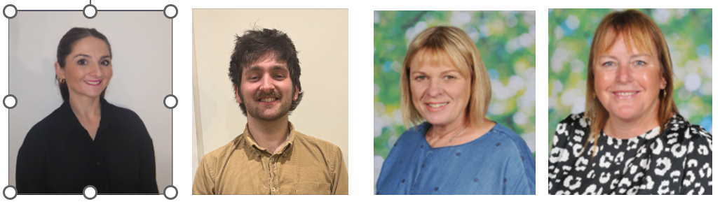

Foundation/Yr 1 Team
Mrs Bridgeman Mr Williams Mrs Edwards Mrs Anderson
Class teacher Class teacher HLTA TA

Slide 3
What to bring …
Book bag
Sun hat
Sun cream
Water bottle
No toys
Fruit snacks are provided but your child can bring their own
Medicines – fill in forms
All items brought into school must be clearly labelled

Slide 4
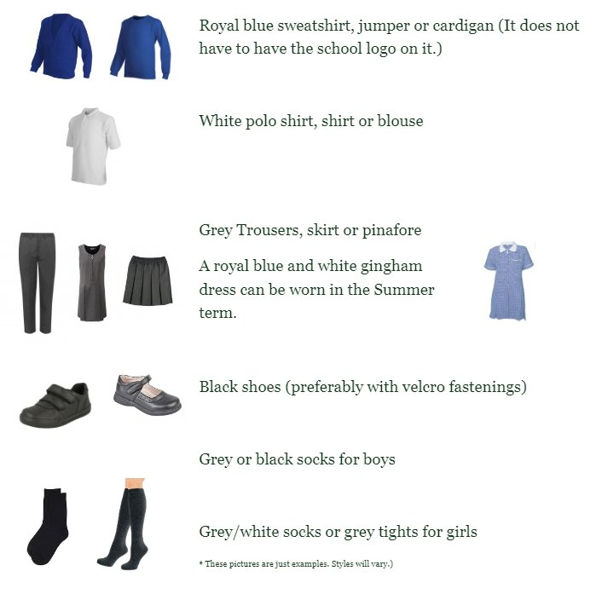
What to wear...
We have a representative from Trutex here today if you wish to order any uniform.

Slide 5
A typical day in foundation at Austin Farm
8.45 - Meet on the playground
8.45 - 9/register – Settling in activities
9 - 9.30 - Read Write Inc – phonics
Learning in the environment
Maths group time
Playtime – this term will be kept in the small playgorund
English based group time
Afternoon
Foundation subjects
Leanring in the envirnoment
Story time

Slide 6
The Early Years Curriculum
Prime areas of Learning and Development
Personal, Social and Emotional Development (PSED)
Physical Development (PD)
Communication and Language (CL)

Slide 7
Specific areas of Learning and Development
Literacy (L)
Mathematics (M)
Understanding the world (UW)
Expressive Arts and design (EAD)

Slide 8



The foundation stage is a crucial time in your child’s education, laying the groundwork for lifelong learning.

Slide 9
We feel communication between home and school is key. We achieve this by -
We have an open door policy.
Parent workshops to know how you can support your child’s learning.
Parents evenings throughout the year.
Regular newsletters to keep you up to date.
Class Dojo for news, reminders, information and direct contact with the team.

Slide 10

Class Dojo https://teach.classdojo.com/#/classes/609be950f6005c6b620630e6/points

Slide 11
Dates for your diary -
Wednesday 2nd July, 1.30pm- 2.30pm – Children to visit classroom
Monday 7th July – Home visits all day
Wednesday 9th July, 1.30pm – 2.30pm - Children to visit classroom
September
W/C - Monday 8th September – Foundation children until 12.15pm
W/C – Monday 15th September – Foundation children staying for lunch until 1.15pm. 3 Foundation children will be invited to stay for 1 whole day during this week.
W/C – Monday 22nd September – Normal hours for all.

Slide 12
Any questions

