Slide 1


Meet the Teacher
Year 5/6: Mr Furby (Mrs Bojang, Maternity leave) TA’S Mrs Robinson, Mrs Hussey

Slide 2
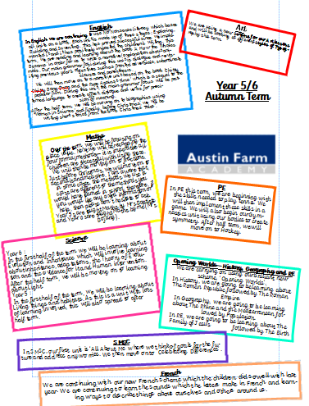
I will send out a hard copy of this as well as upload a digital copy to Dojo

Slide 3
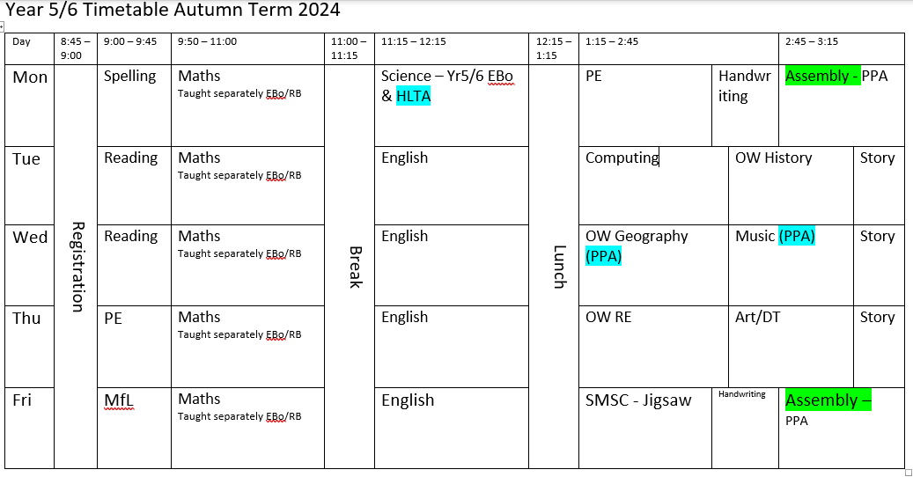
Timetable
Children to wear PE kit on PE days –Monday and Thursday
Notes:
Literacy/ Handwriting/ Reading for Meaning before break – class based with Talk Partners used and ability grouping where needed
Spelling Programme – grouped according to ability/ 3 x per week on Tuesday, Wednesday and Friday
Numeracy after break
Progress regularly reviewed
Teaching assistants deployed to meet needs of children
Additional support to improve progress.

Slide 4
Spellings
Our spelling lesson is taught on a Monday. The spellings are then sent home the following week to reinforce the rule(s) learned. Spellings are tested on Fridays. If your child scores less than 5, they will need to do a retest.
Year 6 will do an additional spelling lesson and will have two different spelling rules per week.
Often, these spellings are the 5/6 common exception words which children need to know by the end of the year.

Slide 5

Accelerated Reader
Book needs to be in school every day
Books are taken home to be read (most evenings please)
Quizzes will take place in class as soon as children have finished reading their book
Children read daily in class
Children should read for at least 20 minutes per day outside school time
The amount of time children are reading is tracked and monitored. Children will have individual targets. Rewards will be celebrated in assembly.

Slide 6

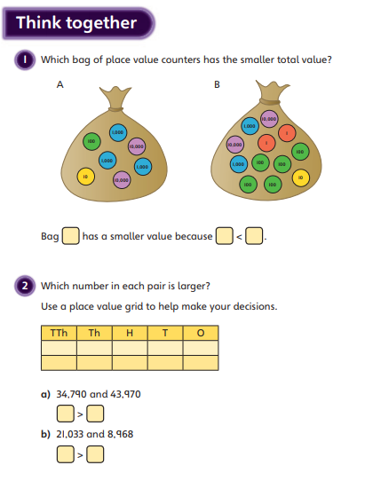
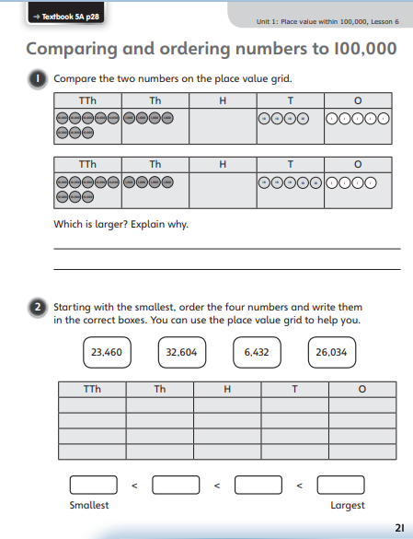
Mathematics
Mastery – prove it, convince me, developing depth in understanding.
Reasoning not just knowledge.
Developing fluency and varied understanding.

Slide 7
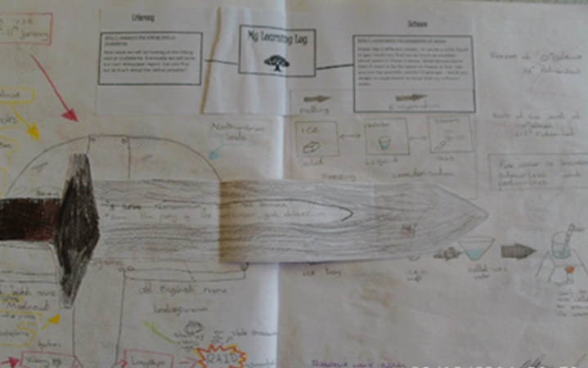
Homework
Currently 1 piece of either Maths or English set on a Monday and due in the following Monday
Spellings
Times Tables Practise
Reading 20 minutes per day

Slide 8
Behaviour
High expectations
Focus on the positives
  Praise
  Recognition board
  Learner of the Week
  Interventions and support
  Regular communication with parents (Dojo)

Slide 9
Uniform and PE kit
Uniform:
Blue jumper/cardigan
White polo top/shirt
Grey/black bottoms/dress
No jewellery (apart from stud earrings)
No trainers
Hair accessories should be in school colours and small
PE kit:
Plain blue t shirt, royal blue shorts/dark coloured jogging bottoms/leggings, school cardigan/jumper, trainers
No nail varnish
Earrings to be removed or taped
Hair tied up

Slide 10
E-safety
We cover e-safety a lot in UKS2 both in SMSC lesson as well as computing lessons
Please monitor your child’s use online
Please monitor their online use of social media and messaging services

Slide 11
Other things to remember…
Entering and exiting school- through class door
Any messages to be passed through Dojo ideally or speak to the office to make an appointment
Children should not be playing on school equipment before or after school
Water bottles must have water in
Fruit/ vegetable for snacks
No chewing gum

Slide 12
Other things to remember…
SATs week will be the week beginning
11th May 2026
Please do not book any holidays etc… for this time.

Slide 13

Any questions or queries?

