Slide 1


Austin Farm Academy
School Information Report
Reviewed September 2025

Slide 2
What is a School Information Report?
The School Information Report answers some of the most frequently asked questions about the school’s provision for children with special educational needs or disabilities (often abbreviated to SEND)
It is reviewed annually or when necessary, throughout the year.

Slide 3

What does having a Special Educational Need or Disability mean?
‘A child or young person has SEND (Special Educational Needs and Disabilities) if they have a learning difficulty or disability which calls for special educational provision to be made for them. A child of compulsory school age or a young person has a learning difficulty or disability if they:
  have a significantly greater difficulty in learning than the majority of others of the same age; or
  have a disability which prevents or hinders them from making use of educational facilities of a kind generally provided for others of the same age in mainstream schools or mainstream post16 institutions.’
  (SEN Code of Practice 2014)

Slide 4
What are the four main areas of need?
The four broad areas of need are:
    Communication and Interaction
    Cognition and Learning
    Social, Emotional and Mental Health difficulties
    Sensory and / or physical needs
A child may have difficulties in more than one broad areas of need. These are explained in more detail within the SEN Code of Practice.

Slide 5
How do we identify if a child has a Special Educational Need?
A child’s achievements and progress are continually assessed throughout the year.
Their progress is tracked and children who are not making expected progress are identified.
Pupil Progress meetings are held three times a year between the class teacher(s), SENDCo (Special Educational Needs Coordinator) and the Head Teacher
The class teacher can use these meetings to raise concerns about a child’s progress and plan further action.
Outside of these meetings, teachers can record their concerns on CPOMS which is monitored by the school SENDCo

Slide 6

What could you do if you think your child has a Special Educational Need?
If you have any concerns, we would welcome you to share them with us as soon as you can.
There are a number of people that you can talk to at school:
      The class teacher
      The School Parent Support Advisor (PSA)
      The SENDCo
      The Head Teacher
If you would like to make an appointment, then please contact the office on 01752 705367, email admin@austinfarmacademy.com or pop in and arrange an appointment through the class teacher –we are always help to help.

Slide 7
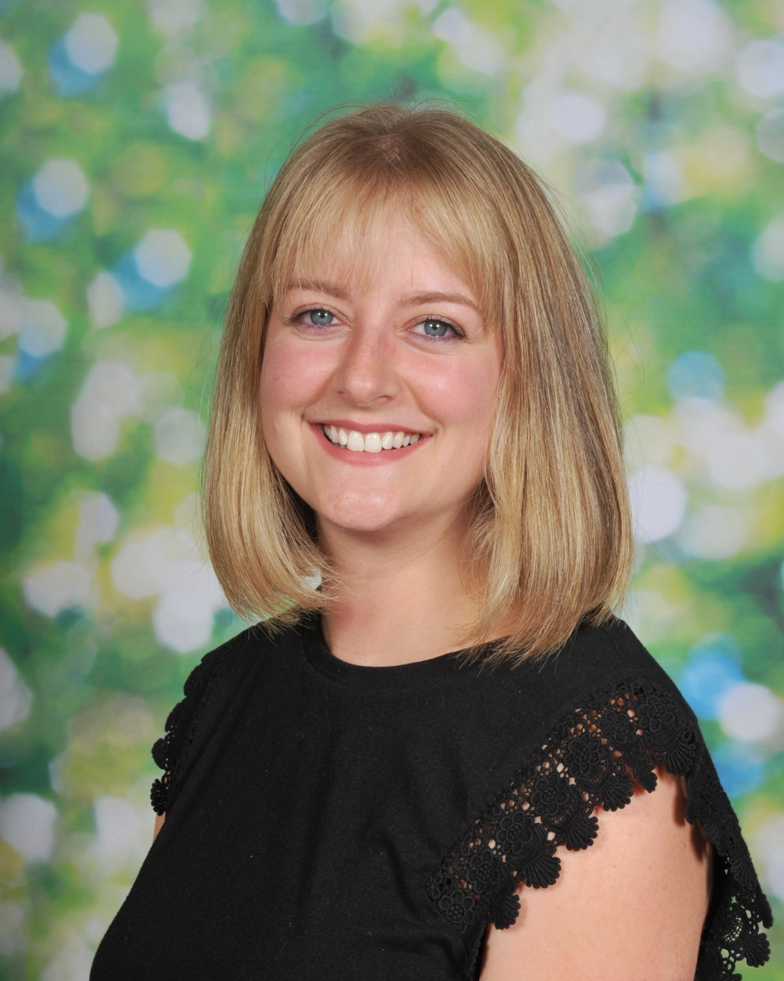
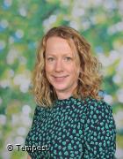
Who can I talk to at Austin Farm?
Mrs Lindsey Hobbins
SENDCo , SLT, DDSL
01752 705367
lhobbins@austinfarmacademy.com
Mrs Ruth Baptiste
Head Teacher , DSL
01752 705367
rbaptiste@austinfarmacademy.com

Slide 8

How are children with Special Education Need or Disabilities (SEND) supported?
All children at Austin Farm are provided with high quality teaching, this includes children with SEND. Children who are performing significantly below their age related expectations may be given a Learning Plan. Here, targets are set to ensure the child meets their small steps of progress. These plans are reviewed and updated regularly and shared with both parents and children. EduKey Provision Map is used to map out a child’s support through Learning Plans. The teacher and SENDCO communicate frequently to discuss the child’s progress and achievements. This forms part of the graduated approach (a model of action and intervention).

Slide 9
How are children with Special Education Need or Disabilities (SEND) supported?
The class and school environment are assessed to meet the child’s needs. More information can be found in the Accessibility Policy which can be found on our school website. All children at Austin farm are encouraged to take part in extracurricular activities. Staff will try and support children in these activities in the same way they are supported in school. In some circumstances, we would welcome the parent of the children with SEND support during the clubs. This can be arranged in discussion with the school. Children who have social, emotional and mental health needs (often called SEMH needs) are encouraged to share their feelings and thoughts. Spiritual, Moral, Social and Cultural (SMSC) lessons provide the children with strategies on how to do this. Additionally, our ELSA trained teaching assistants support children’s well-being. If a child has significant needs where they are working significantly below their age related expectations, an Education Health Care Plan (EHCP) may be applied for. More information on EHCPs can be found via Plymouth City Council. https://www.plymouthonlinedirectory.com/plymouthlocaloffer/ehcp

Slide 10
What sort of support might be put into place for my child within the classroom?
Quiet space learning
Pre-teaching
Use of equipment
Precision Teaching
Word banks
Teacher and TA support
Visual timetables
Scaffolded and adapted activities

Slide 11
How do we involve others in meetings about your child?
There are times that extra advice or help may be sought by the SENDCO or Head Teacher (These referrals are made with support of the parent.) . Examples of support are: Educational Psychology (EP) Team, Communication Interaction Team (CIT), Speech and Language Multi Agency Support Team (MAST). Once help of a specialist agencies has started, the SENCO, class teacher, parent and agency communicate as and when appropriate to discuss the child’s needs and developments If the meetings are around one child a Team Around Me (TAM) is held. These are held between 6 and 8 weeks. A log of each meeting is kept and actions are set. If the family require support from multiple agencies an Early Help Assessment Tool may be completed and EHAT meetings are held every 6 weeks. Minutes are recorded at these meetings and actions are set.

Slide 12

How are children’s views used at Austin Farm?
All children are encouraged to share their views with their class teacher, teaching assistant or any adult member of the school team. When an outside agency referral is completed, we record their thoughts and feelings through a Pupil Voice prompt sheet that encourages them to say what they think and feel about school(assisted by an adult if required.) If a meeting is held, and it is appropriate, children will share their thoughts and feelings. If this is not appropriate, their thoughts and feelings are shared on their behalf. Children with SEND are invited to attend meetings where they can.

Slide 13

How are pupils with SEND and their families supported when leaving or joining us?
End of Primary Phase When a child leaves at the end of the primary school the SENDCO will communicate with the SENDCO of the secondary school they will be attending. Information about the child’s needs and provision is passed on via the Transition Portal. The child’s class teacher and, if necessary, the child’s 1-1 support will also be part of these discussions. It is also possible that the parent will be invited to a transition meeting with the receiving school to discuss specific needs. Some children with a special educational need and/or disability may require additional visits to their next school. This is known as an ‘Enhanced Transition’. The SENDCO and the receiving SENDCO will arrange this and parents will be informed. The SENDCO and school’s administrator will ensure information about the child’s needs and provision is passed on for children who are in foundation or years one to six and are moving to a new school.

Slide 14

How are pupils with SEND and their families supported when leaving or joining us?
Joining us? For children arriving to the school with an established special educational need and/or disability, parents are encouraged to meet with the class teacher or SENDCO as soon as possible to determine the support and provision required. A meeting with child’s departing school and the parents may be called to discuss provision. Information from the previous school will be requested as soon as the child arrives.

Slide 15

How are pupils with SEND supported when moving to a new class?
This is called transition. Children will move to a new class every year. What will be new? In most cases, a new classroom and a new class teacher. What will be the same? As we are one form entry, the children will be the same Any specific support your child needs. How do we manage the changes? 2 days in the Summer Term with your child’s new teacher completing ‘getting to know you’ activities. Enhanced transition visits where required. Detailed transition meeting between current and new teacher. Transition booklets and visual timetables shared ahead of the new academic year. If there is a TAM, EHAT or Annual Review (children with EHCPs) meeting, the new class teacher will attend End of year Learning Plans are written by the current teacher to ensure children are working on individualised and appropriate targets in the new academic year.

Slide 16
Where can I find more information about our approach to supporting children with SEND?
Please visit https://www.austinfarmacademy.com
On this page you will find information about the schools approach to supporting children with SEND, including the Graduated Response, as well as useful information about Plymouth’s Local Authority’s approach to supporting children with SEND.

Slide 17
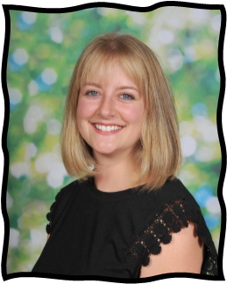
What expertise do staff at Austin Farm have?
Mrs Ruth Baptiste
THRIVE Trained
Normal magic training
Mrs Lindsey Hobbins
Therapeutic Mentoring

Slide 18
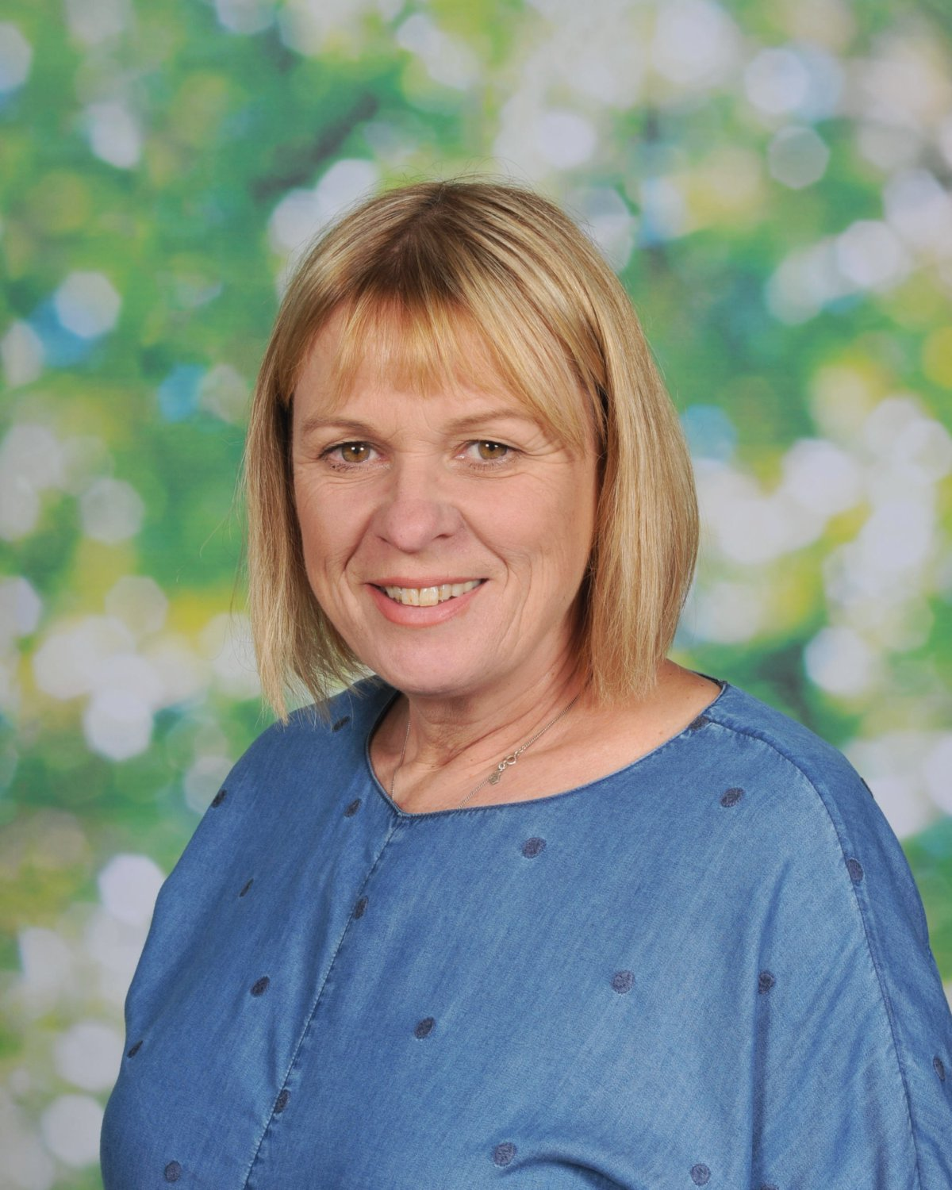
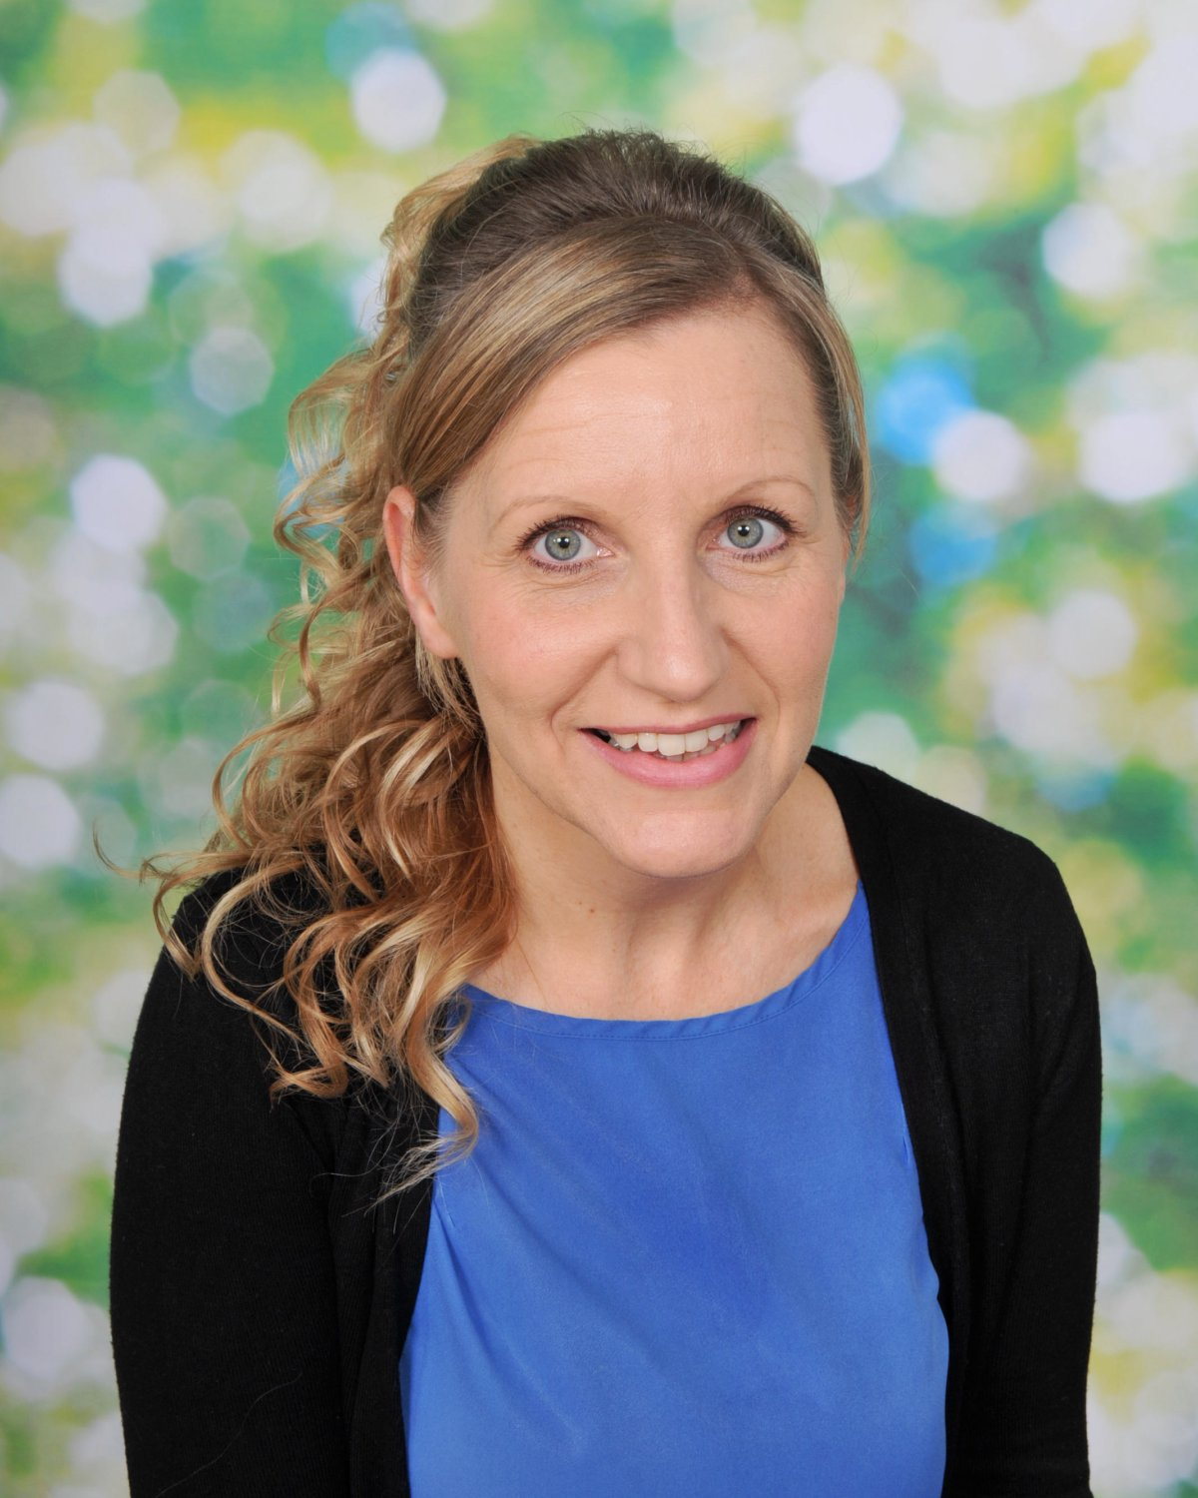
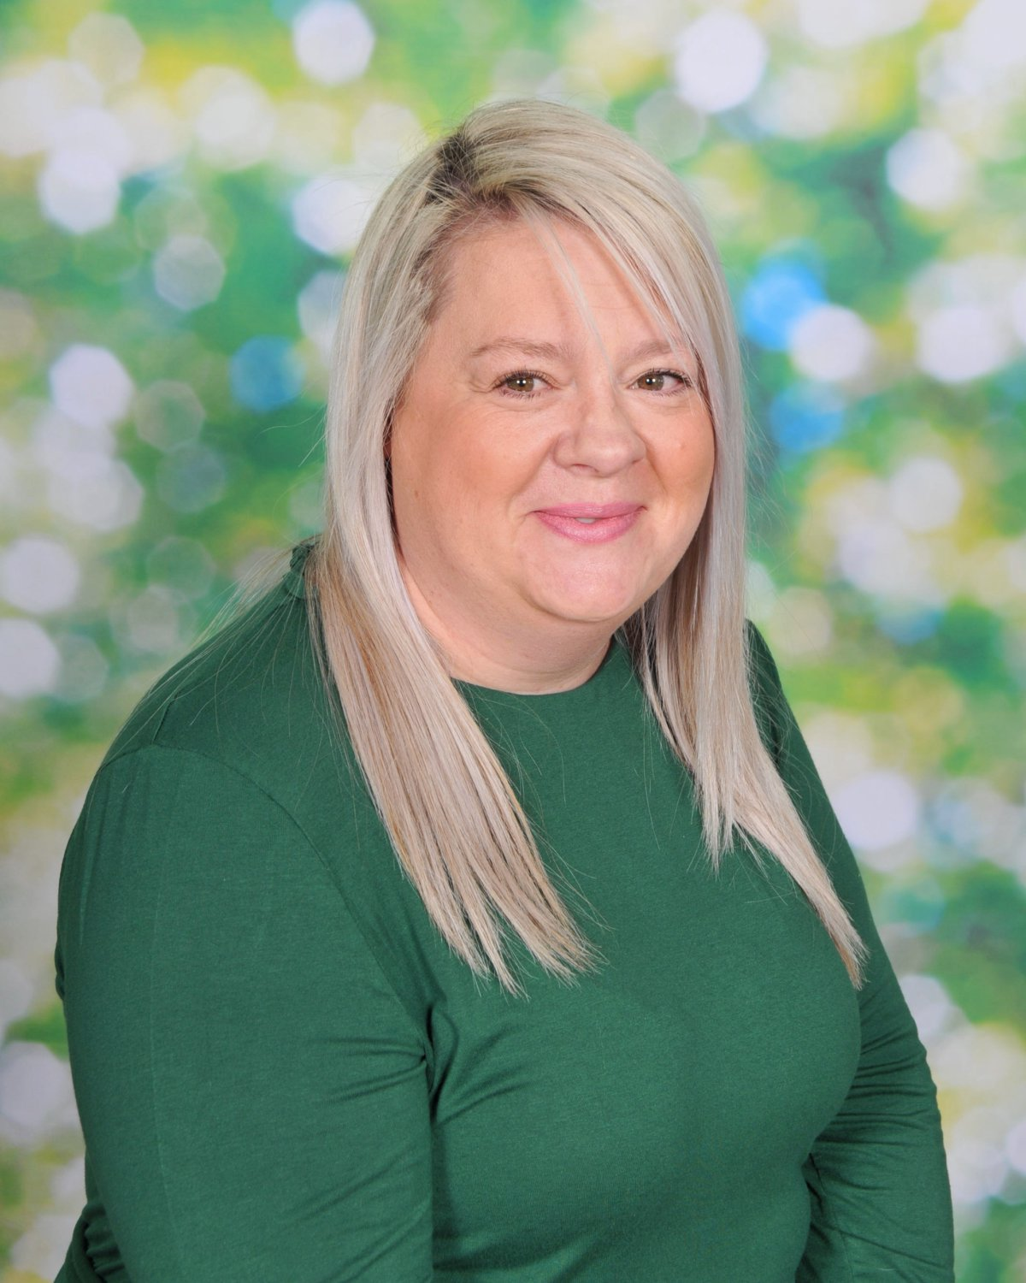
What training or expertise do staff at Austin Farm have?
Mrs Edwards
HLTA
Theraplay
BLAST
Cued Articulation
Mrs Claire Kastner
Grieving in Puddles trained (up to Level 3)
Therapeutic Mentoring
Mrs Hussey
ELSA training
AET training
SEND diploma Level 3
Theraplay
Attachment Training
In addition to individual staff training, all teaching and teaching assistant staff have training throughout the year to update skills and provide support to children in our school community; these include;, attachment training, precision teaching, speech and language training, Adverse Childhood Experiences, Graduated Approach Training and target setting.

Slide 19


Where can I go for further advice?
Parents can receive advice and support from Plymouth PIAS team. http://www.plymouthias.org.uk/ The SEN Code of Practice guide for parents https://www.gov.uk/government/publications/send-guide-for-parents-and-carers There are also lots of website for specific needs that can be recommended. Mrs Gilbert can point you in the direction of these websites if required. Here are a few that might be of use (please click on the links below): British Dyslexia Association National Autistic Society ADHD guide Speech and Language `

Slide 20
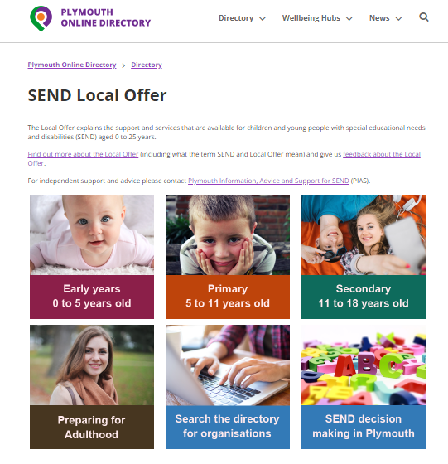
Where do I go to find information about Plymouth’s Local Offer for children with SEND?
Information about Plymouth’s local offer can be found here; https://www.plymouthonlinedirectory.com/article/182/SENDLocal-Offer

Slide 21
What can I do if I am not happy with the school’s provision? How can I share my concerns?
If you are not happy with the school’s provision for your child, then we recommend the following steps; Talk to your child’s class teacher Share your concerns with the SENDCO or Head Teacher If you feel that your concerns are still not resolved, then please visit our website where details can be found on how to raise a complaint within the complaints policy.

