Slide 1






Welcome to Year 2/3

Slide 2


Slide 3


Slide 4
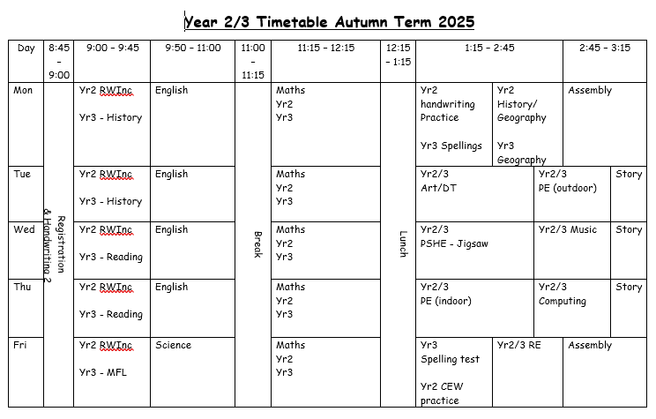
Example timetable
Notes:
Discuss separate lessons

Slide 5

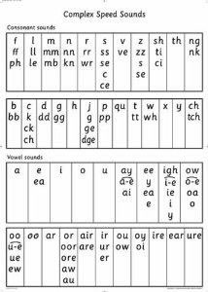
Teach skills for reading and writing
Daily 45 minute sessions
Grouped across KS1 (Foundation to be included later in the year)
Taught in small groups

Slide 6

Reading Books – Book Bag Books
These will be explicitly linked to your child’s RWI group and will be the same colour as their group in school.
Books will build upon learning in school.
They are given out after the first read in school – they are signed in and out by each reading teacher.

Slide 7

Reading Books – Extra book
Additional book
After the third read, your child’s RWI teacher will allocate a book and quiz. They would have been practicing this book in class and by this point, the children have developed their fluency and expression.

Slide 8
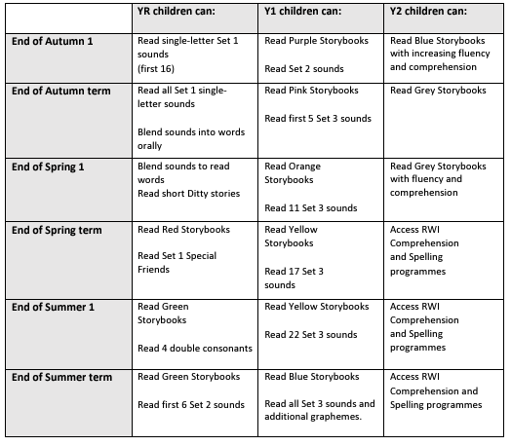
Reading groups and colours

Slide 9

Reading
2/3 forms of reading:
Book Bag Book (changed by RWI teacher) OR Accelerated Reader (information to follow)
Follow up class book – once children have read this three times in class.
Library book (read to your child by an adult) – to develop comprehension and a love of reading. We will aim to change these every Thursday afternoon (with Mrs Robinson).

Slide 10

Whole Class Reading
Focusses on the following skills:
Vocabulary
Inference
Predicting
Sequencing and summarising
Retrieval and explanation
Two lessons per week
Children take it in turns to read to the class whilst others follow
New text every 1-2 lessons
Live feedback for children
Termly teaching of how to complete a reading comprehension

Slide 11

Accelerated Reader
This is for those children who are on the RWi comprehension programme. Accelerated Reader is a programme which helps teachers to manage and monitor children’s independent reading practise. Your child picks a book at their own level and reads it at their own pace. When finished, your child takes a short quiz on the computer – by passing the quiz the children show their understanding of the text they have read. These quizzes will be completed during school time. The children gain points by reading the books and these achievements will be celebrated at school.
Since they are reading books at their own reading and interest levels, children are likely to be successful and enjoy the books and quizzes. Best of all they learn at their own pace. As with everything, performance improves with practise and children who read at least 15 minutes a day with a 90% comprehension rate on the AR quizzes see the greatest gain. Please encourage your child to read at home, discuss their books, ask questions about what they have read. Together, we can help every child succeed and further develop their love of reading.
Notes:
Reading time to be increased throughout the year

Slide 12
Accelerated Reader
Book needs to be in school at all times
Children will need to bring a book bag/small backpack to carry their book in if possible
Quizzes will take place in class as soon as children have finished reading their book
Children can go to the library to change books any day, once their quiz is completed
Children should read for at least 15 minutes per day
Certificates will be given out for achievements in our weekly celebration assembly

Slide 13

Library books
Please read the resource on the website with ten top tips for reading stories to your child.

Slide 14


English and Handwriting
Taught in class following the Devon Education Services BookWrites.
Cursive script introduced (once individual letters are formed correctly)
Focus on teaching the skills for writing, including spelling, components of writing, comprehension of text and grammar
Notes:
Discuss importance of letter formation in reaching ARE

Slide 15

Mathematics (Y2 and Y3 separate)
Power Maths scheme
Emphasis on children becoming fluent at
number facts and skills beginning with numbers up to 10/20/100.
Mastery curriculum
Use of concrete resources and emphasis on
talk.

Slide 16
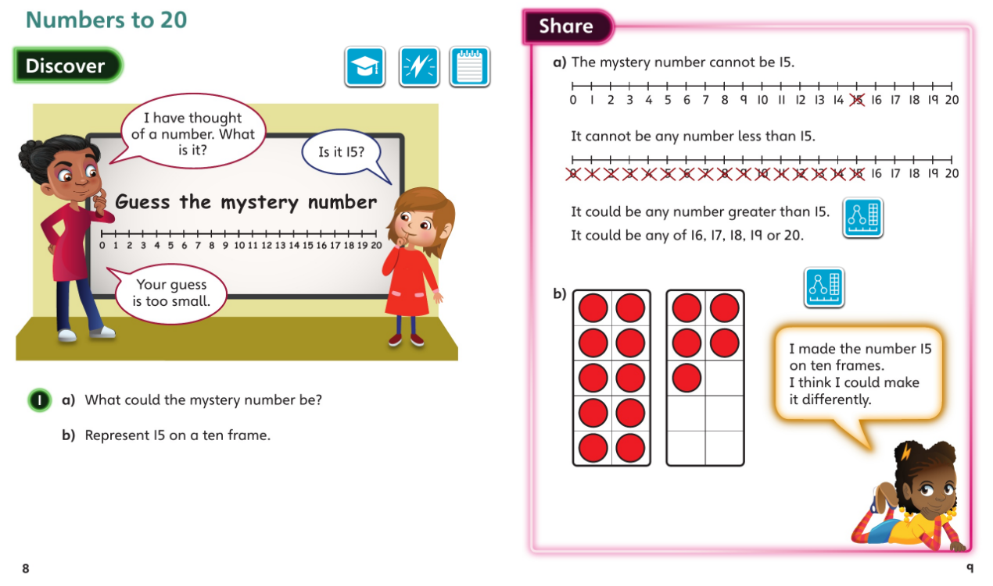
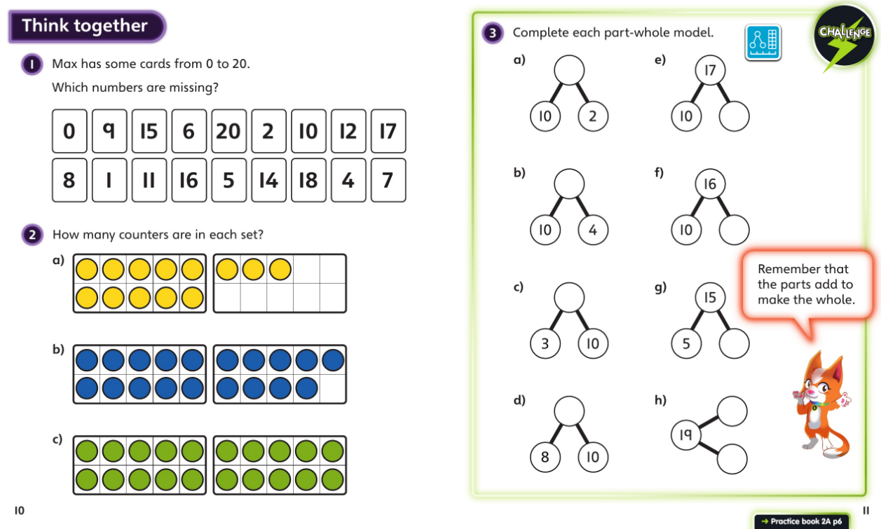
Mathematics

Slide 17
Homework
 | Maths/English/Topic | Spelling | Reading
Monday | Homework out. | Spellings out. | Reading
Tuesday |  |  | Reading
Wednesday |  |  | Reading
Thursday |  |  | Reading
Friday | Homework due in. | Spelling test | Reading
There will be a focus on times tables until children are secure in knowing these off by heart.

Slide 18
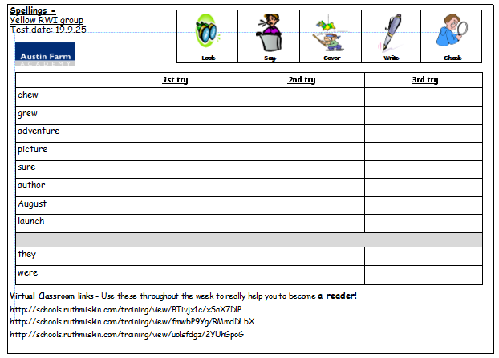
Spellings – Year 2
Year 2’s spelling lists link directly to the sounds taught the previous week in the RWi sessions. Children will take the words from the lesson to practise at home. Spellings are tested on Fridays.
Children will also have two common exception words.
VC links to be used.
Notes:
VC links to be accessed by QR code soon!

Slide 19
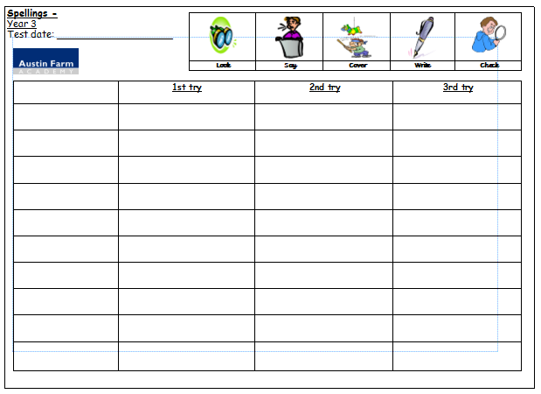
Spellings – Year 3
Year 3’s spelling lesson is taught on a Monday. Children will take the words from the lesson to practise at home. Spellings are tested on Fridays.
Following the No Nonsense Spelling Programme
Some weeks, a rule isn’t taught. Instead children work on words from the Year 3/4 spelling list from the National Curriculum.

Slide 20
Attendance
5 minutes late, does it really matter ?
Lateness = Lost Learning
(Figures below are calculated over a school year)
5 Minutes late each day - 3 days lost
10 Minutes late each day - 6.5 days lost
15 Minutes late each day - 10 days lost
20 Minutes late each day - 13 days lost
30 Minutes late each day - 19 days lost

Slide 21

Entry and Exit from School
Entry and exit near Year 2/3 outside area (wet weather plan to be discussed)
School starts at 8:45
Collection at 3.15
Mrs Robinson on a Thursday afternoon
Mr Williams on a Friday.
Safety is paramount – messages after all children have been collected
Inform of change in the morning or via school office (not Class Dojo)

Slide 22
Expectations
Big focus on developing independence.
School Values:
Resilient
Proud
Respectful
Toilet/drink access during the day…

Slide 23
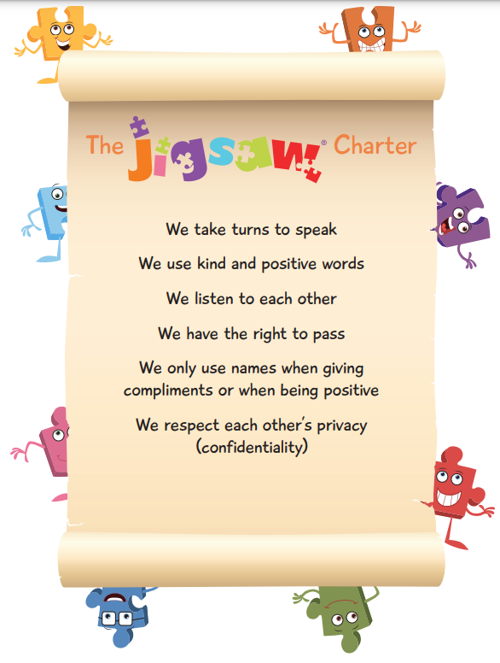

Expectations
High expectations in all that the children do, including any work completed at home.
There is a real focus on positive and desirable behaviour
  Class Dojo communication
  Praise
  Learner of the Week
  Interventions and support

Slide 24
Extra Information
Water bottles to be in school each day and clearly labelled
KS1 children provided with fruit snack each day (children can bring own fruit in bookbag)
Dinners to be ordered at home (see the office if any problems)
Names in all uniform and coats
PE kits to be worn on Tuesday and Thursdays.

Slide 25

Questions and Queries
Any questions.
Also feel free to send a message directly via Class Dojo.

