Slide 1

Welcome to Year 1

Slide 2
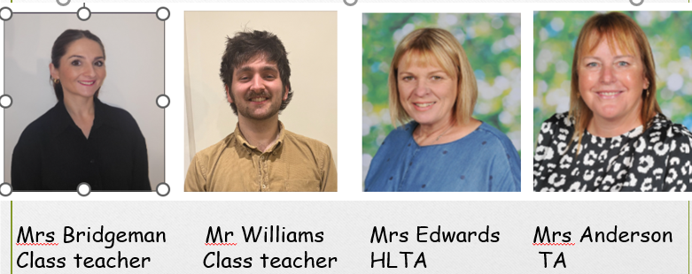
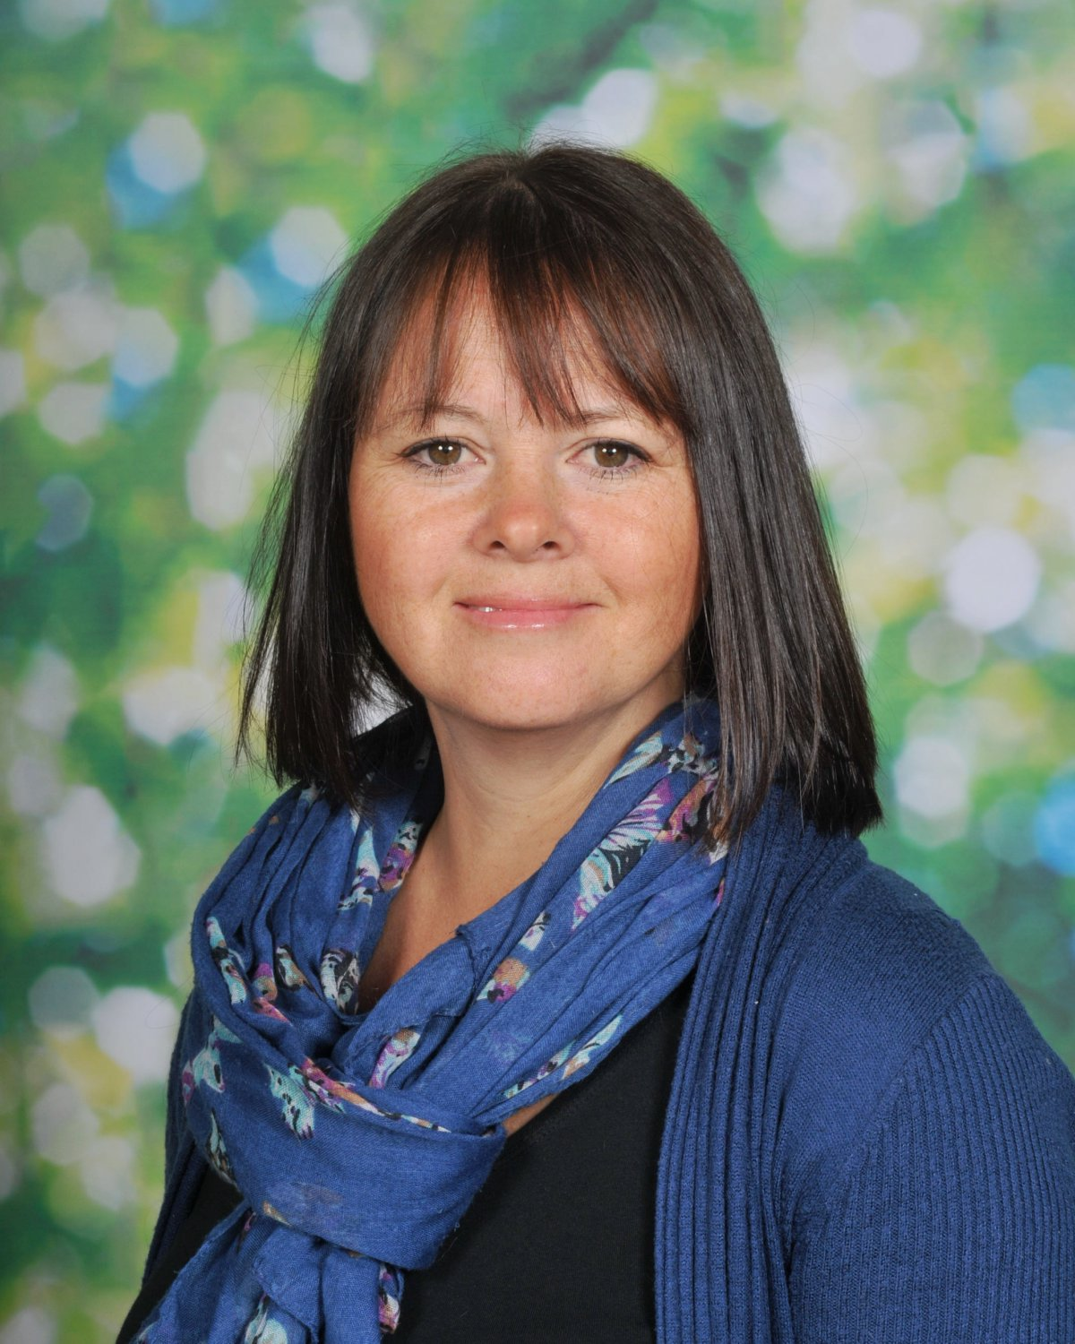

Foundation/Yr 1 Team
Mrs Robinson HLTA

Slide 3
What to bring …
All items brought into school must be clearly labelled
Book bag
Water bottle
No toys
Sun cream
Sun hat
Fruit snacks are provided but your child can bring their own
Medicines – fill in forms

Slide 4
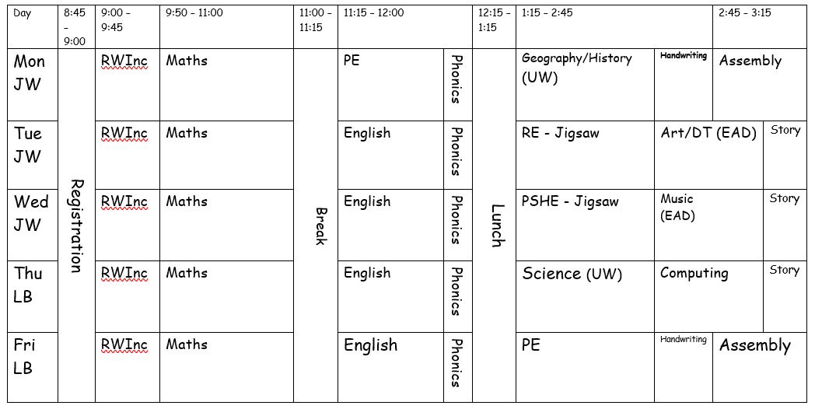
Example of our weekly timetable
Children can wear PE kits to school on Monday and Friday.

Slide 5
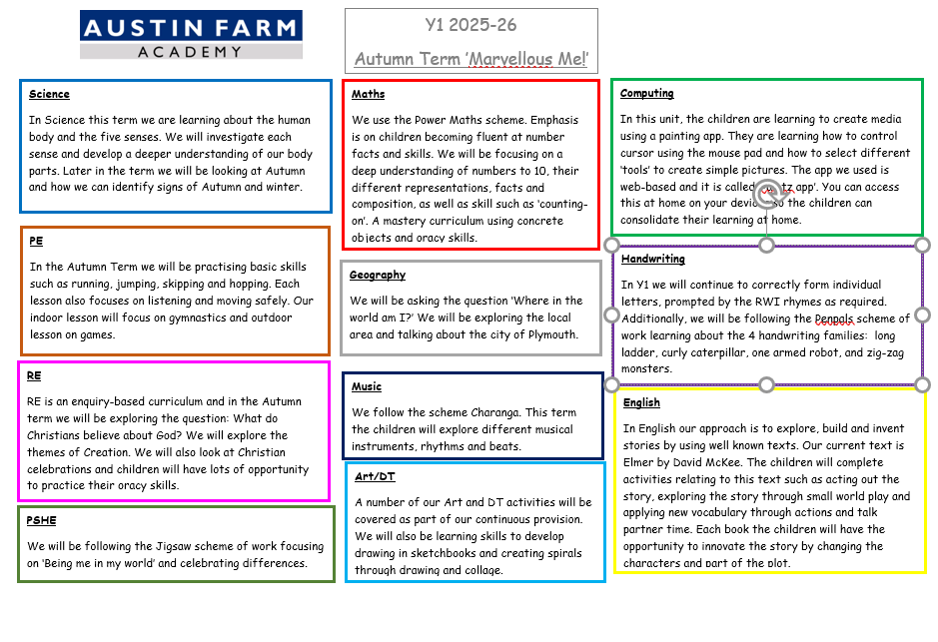
Autumn 2025
Curriculum letter

Slide 6
Expectations
Year 1 is an important step up from Reception.
Children begin to build more independence in learning.
We focus on developing fluency in reading, building confidence in writing sentences, and understanding numbers to 20 and beyond.
Most learning is still practical, active, and engaging to support transition.
Homework
Attendance – It is important that, if well enough, your child attends school. At the end of each term children with 100% attendance get to have a golden time with Mrs B.

Slide 7


Behaviour at Austin Farm
Focus on the positives
  Praise – notice good behaviours
  Rewards – Dojo points/Recognition board
  Learner of the Week – celebration assembly on Friday.
  Interventions and support
  Reinforcing good behaviour
  Regular communication with parents (Dojo)

Slide 8

Homework
Home work – Reading 5-10 minutes per day
Taking the time to read with your child for just 10 minutes per day equates to over 60 hours in a year! Additional reading at home has proven to boost a child’s school performance, as well as increase vocabulary, builds strong communicational skills, improve self-esteem, and spark their imagination.
Weekly spellings according to their RWI group – Given out on a Friday and teasted in RWI groups the following Friday.
Daily times tables (starting at x10)
When we reach the summer term, the children will be asked to complete small tasks each week. A dojo will be sent out explaining this.

Slide 9

RWI
Developed to teach skills for reading and writing
Daily 45 minute sessions
Grouped across KS1 (Foundation to be included later in the year)
Taught in small groups

Slide 10

Year 1 common exception words

Slide 11

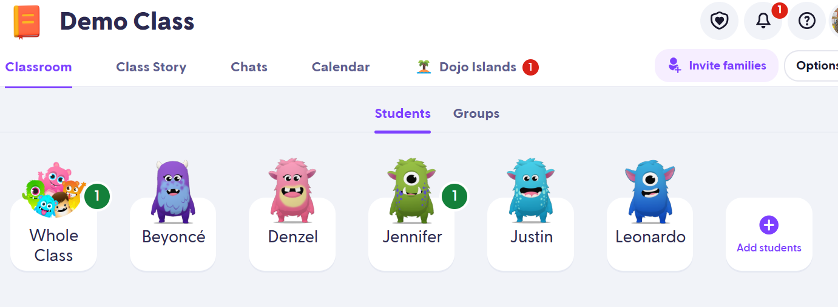
Class Dojo https://teach.classdojo.com/#/classes/609be950f6005c6b620630e6/points

Slide 12
Trips and events
We will let you know of dates for any trip/events as soon as we know.

Slide 13
Questions ?

Slide 14
Thank you for listening!
Please help yourself t a copy of the year 1 high frequency word mat
Number formation sheet
Tips to help your child read sheet

