Slide 1






Welcome to Year 1/2

Slide 2
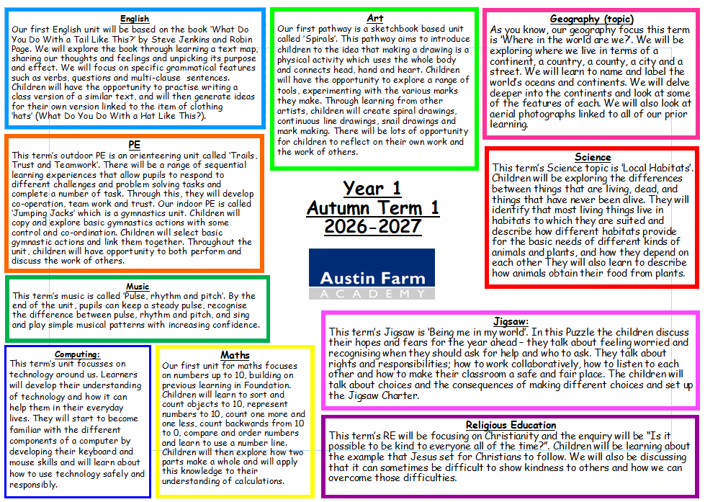

Slide 3


Slide 4
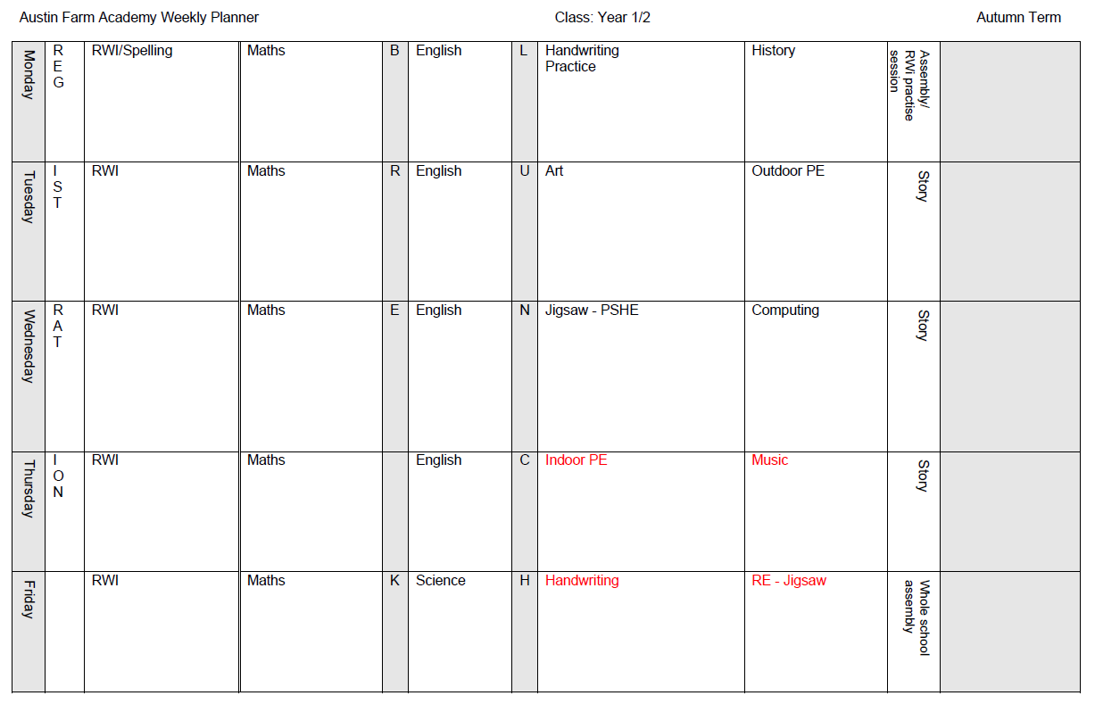
Example timetable
Notes:
Discuss separate lessons

Slide 5

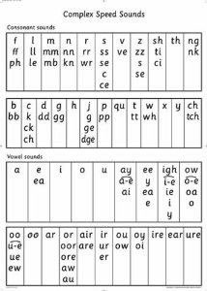
Teach skills for reading and writing
Daily 45 minute sessions
Grouped across KS1 (Foundation to be included later in the year)
Taught in small groups

Slide 6

Reading Books – Book Bag Books
These will be explicitly linked to your child’s RWI group and will be the same colour as their group in school.
Books will build upon learning in school.
They are given out after the first read in school – they are signed in and out by each reading teacher.

Slide 7

Reading Books – Extra book
Additional book
After the third read, your child’s RWI teacher will give you another book. They would have been practicing this book in class and by this point, the children have developed their fluency and expression.

Slide 8
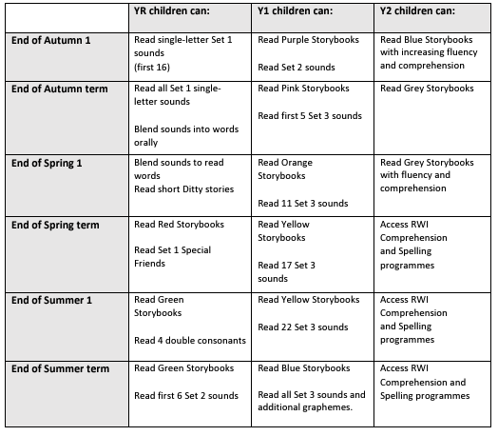
Reading groups and colours

Slide 9

Reading
2/3 forms of reading:
Book Bag Book (changed by RWI teacher) OR Accelerated Reader (information to follow)
Follow up class book – once children have read this three times in class.
Library book (read to your child by an adult) – to develop comprehension and a love of reading. We will aim to change these every Thursday afternoon (with Miss Hunter).

Slide 10

Library books
Please read the resource on the website with ten top tips for reading stories to your child.

Slide 11


English and Handwriting
Taught in class following the Devon Education Services BookWrites.
RWi handwriting scheme to be used twice weekly.
Focus on teaching the skills for writing, including spelling, components of writing, comprehension of text and grammar
Notes:
Discuss importance of letter formation in reaching ARE

Slide 12

Mathematics (Y1 and Y2 separate)
Alternating between Year 1 and Year 2
Power Maths scheme
Emphasis on children becoming fluent at
number facts and skills beginning with numbers up to 10/20/100.
Mastery curriculum
Use of concrete resources and emphasis on
talk.

Slide 13
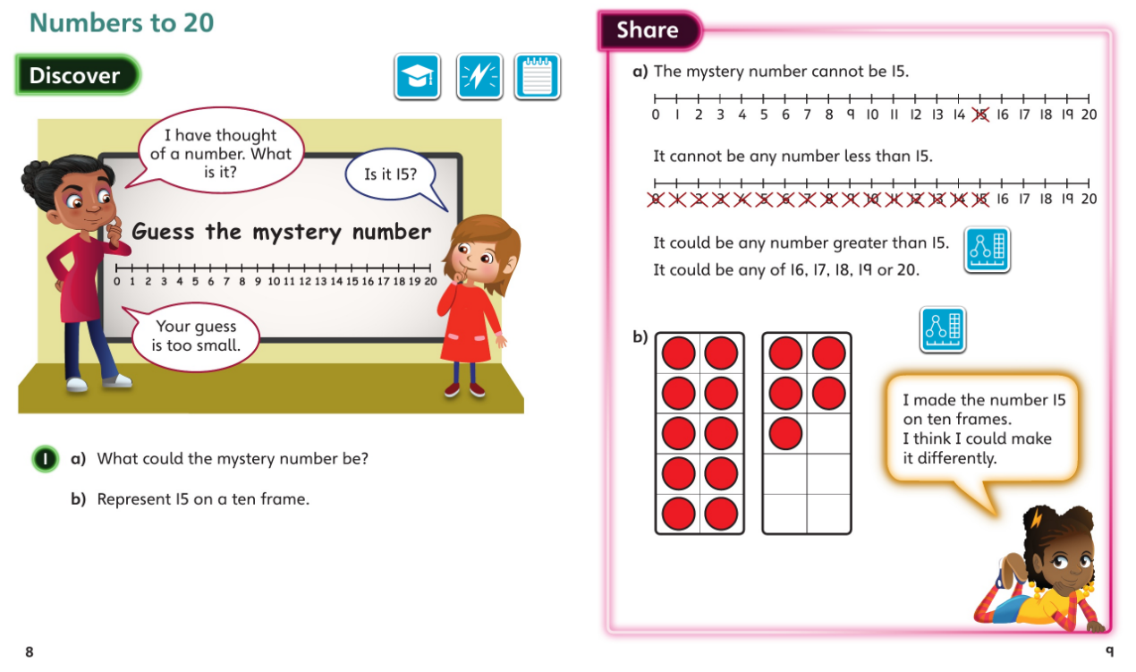
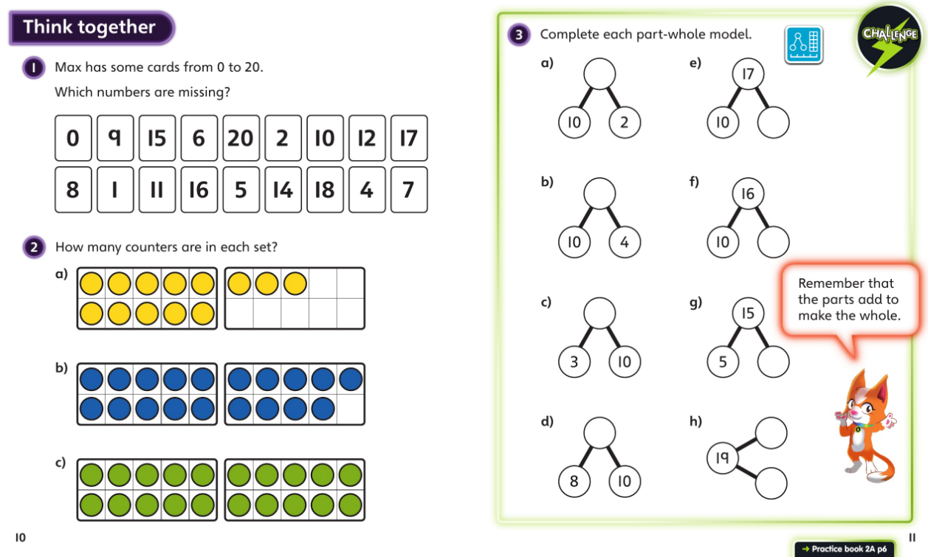
Mathematics

Slide 14
Homework
 | Maths/English/Topic | Spelling | Reading
Monday | Homework out. | Spellings out. | Reading
Tuesday |  |  | Reading
Wednesday |  |  | Reading
Thursday |  |  | Reading
Friday | Homework due in. | Spelling test | Reading
There will be a focus on basic skills, number formation, number bonds and times tables until children are secure in knowing these off by heart.

Slide 15
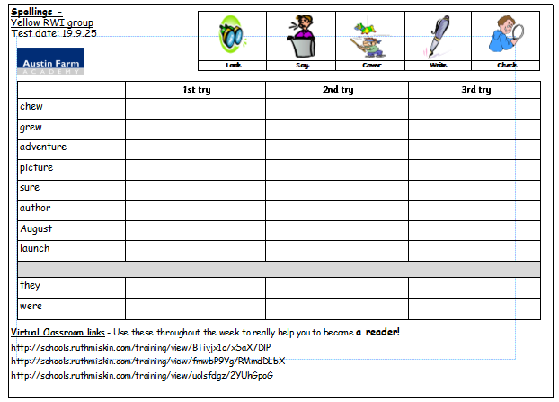
Spellings
All spelling lists link directly to the sounds taught the previous week in the RWi sessions. Children will take the words from the lesson to practise at home. Spellings are tested on Fridays.
Children will also have two common exception words.
VC links to be used.
Notes:
VC links to be accessed by QR code soon!

Slide 16
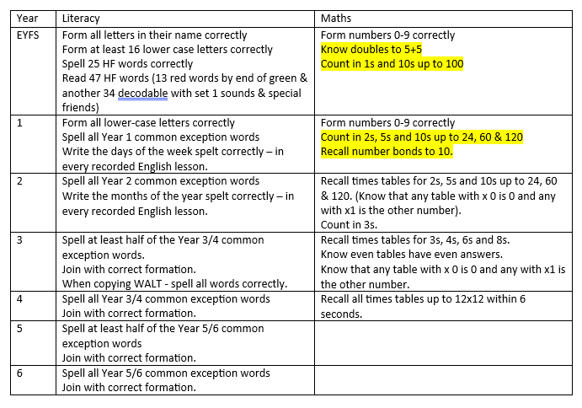
Basic expectations

Slide 17
Attendance
5 minutes late, does it really matter ?
Lateness = Lost Learning
(Figures below are calculated over a school year)
5 Minutes late each day - 3 days lost
10 Minutes late each day - 6.5 days lost
15 Minutes late each day - 10 days lost
20 Minutes late each day - 13 days lost
30 Minutes late each day - 19 days lost

Slide 18

Entry and Exit from School
Entry and exit near Year 1/2 outside area (wet weather plan to be discussed)
School starts at 8:45
Collection at 3.15
Miss Hunter on a Thursday afternoon
Mr Williams and Miss Hunter on a Friday.
Safety is paramount – messages after all children have been collected
Inform of change in the morning or via school office (not Class Dojo)

Slide 19
Expectations
Big focus on developing independence.
School Values:
Resilient
Proud
Respectful
Toilet/drink access during the day…

Slide 20
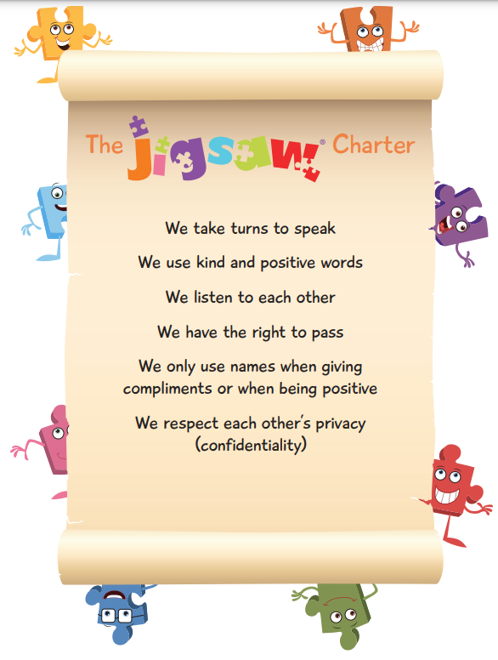

Expectations
High expectations in all that the children do, including any work completed at home.
There is a real focus on positive and desirable behaviour
  Class Dojo communication
  Praise
  Learner of the Week
  Interventions and support

Slide 21
Extra Information
Water bottles to be in school each day and clearly labelled
KS1 children provided with fruit snack each day (children can bring own fruit in bookbag)
Dinners to be ordered at home (see the office if any problems)
Names in all uniform and coats
PE kits to be worn on Tuesday and Thursdays.

Slide 22

Questions and Queries
Parent declaration – please complete and return.
Any questions.
Also feel free to send a message directly via Class Dojo.

